Slide 1
Gates Cambridge Scholarships
Insert event name here
Last updated: 9 September 2020
Notes:
15 minute presentation followed by Q&A
Update title for each event

Slide 2
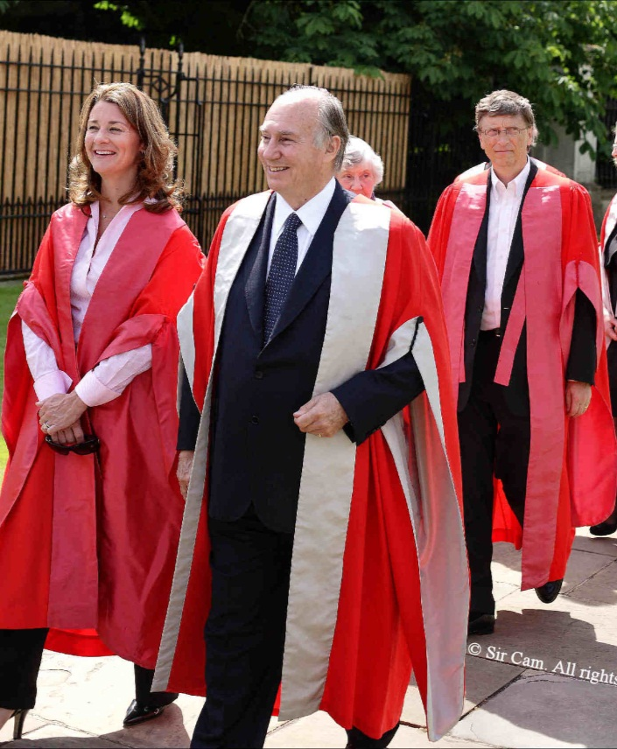
Presentation sections
About the scholarship
Application & selection
Q&A
Notes:
Scholarship – cover the basics
Application and selection – key points
Scholars and Alumni – examples of some scholars from [country/area]
Q&A

Slide 3
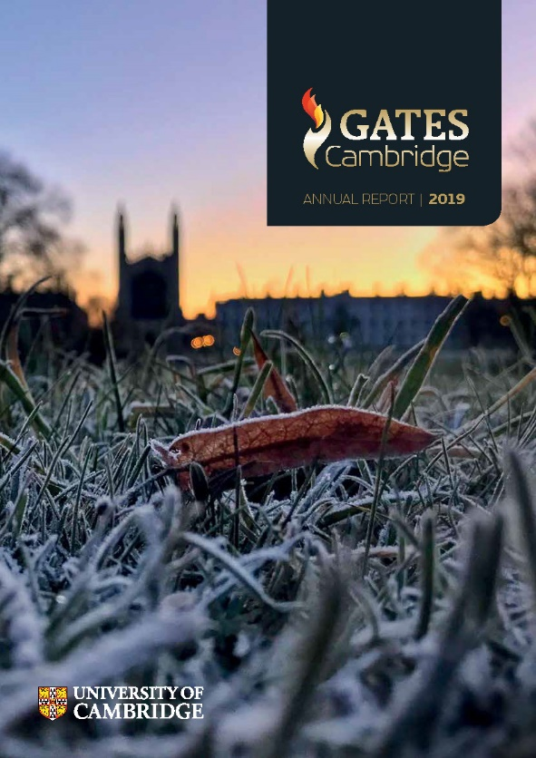
The scholarship
Overview
What: full-cost scholarships for a postgraduate degree in any subject at the University of Cambridge
History: established in 2000 by US$210m donation from Bill and Melinda Gates Foundation to University of Cambridge
Aim: to build a global network of future leaders committed to improving the lives of others
Notes:
What –one of most prestigious and open scholarships in the world
History – largest ever single donation to a UK university
Aim – more than just a cheque – creating a community and expectation is to have a positive impact in your chosen area

Slide 4
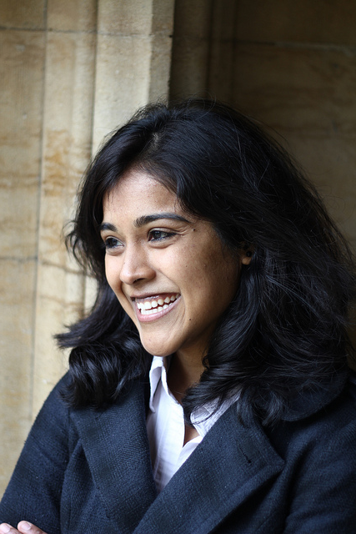
The scholarship
Who is eligible
Citizens of all countries except the UK
Must gain admission to one of the following full-time graduate programs at Cambridge:
PhD
MSc/MLitt
Masters
No age limit
Notes:
Openness – any citizen can apply for any subject at Cambridge (except those from UK)
Age - many applicants straight out of university, but plenty of mature applicants with industry experience and/or families also apply

Slide 5
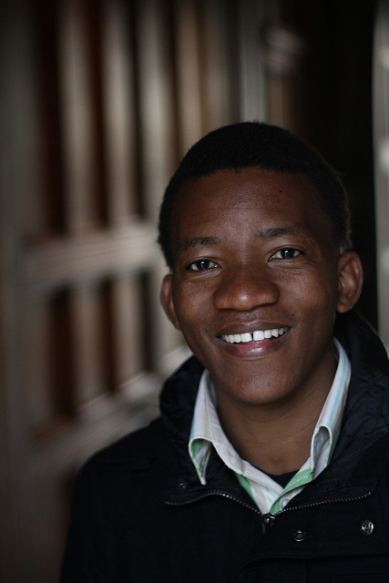
The scholarship
Value
Core components (per year)
University and College fees
Living allowance of £17,500 for 12 months (9-12 months for MPhils, up to 4 years for PhDs)
Return airfare
Visa & associated costs
Discretionary components
Family allowance (children)
Academic Development
Hardship funding
For full details see our current scholars page
Notes:
Headline: One of, if not, the most generous international scholarships for study in the UK.
Discretionary components (upon application):
Family allowance – to bring your total income into line with the University’s suggested funding guidelines for families.
Academic Development – up to £500 per year for conferences, language courses, etc.
Hardship funding – for unforeseen difficulties

Slide 6
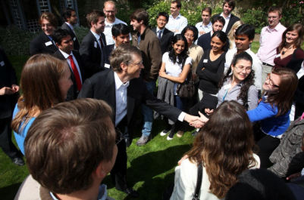
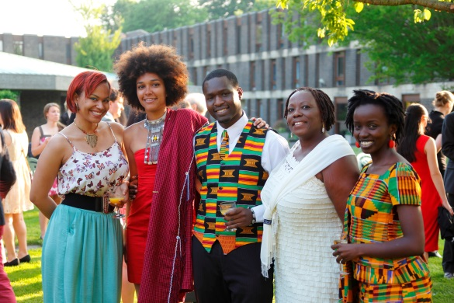
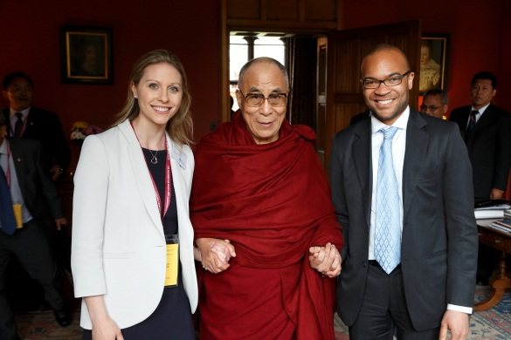
The Scholarship
Our community
At Cambridge
Diverse, active & integrated community (c.240)
Scholars’ Council and events
Scholars’ Common Room
Learning for Purpose
Beyond Cambridge
A global network
1,500+ alumni from 100 countries
Alumni Association
Improving lives in multitude of ways
Notes:
Diverse community – community is a big part of the Gates Cambridge experience.
Scholars’ Council and events - Council organises a number of events during the year including: Orientation for new Scholars, lectures, termly colloquia, academic clusters, social activities for Scholars and their families/guests to underpin the Gates community at Cambridge. Professional Development programming by Council – Learning for Purpose - an important part of the Scholar experience.
Scholars’ Common Room – physical space and focus of much Gates Cambridge activity, computer lab
Integrated– Gates Cambridge has its own distinct community but is also part of the broader Cambridge community -- College, department, societies.
Many opportunities – in all communities – Colleges, departments and wider University offer a lot; Gates Cambridge also full of events and the capacity to organise them
Beyond Cambridge – connection is lifelong and access to passionate and diverse network of alumni

Slide 7
Application & Selection

Slide 8
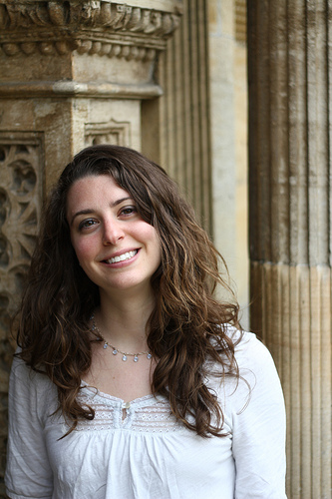
Application & selection
What you apply for
One application form for:
Postgraduate admission to the University
College membership
A Gates Cambridge Scholarship
Other Cambridge funding
Full details www.graduate.study.cam.ac.uk
Notes:
Gates Cambridge is integrated into the University and academic departments – not applying for the scholarship, but admission and funding. We do not place Scholars.
Important that there is a good fit between you and your experience ands skills and the course for which you are applying.
Funding is highly competitive so use the search took to apply for as much funding as you are eligible for – you might not get a named award but it may be possible to package up funding from various sources. Also apply to non-Cambridge sources.
Colleges – it’s a very good system but can seem bewildering to those outside Cambridge. You can read up about Colleges on https://www.graduate.study.cam.ac.uk/colleges and also watch films about the College experience for postgraduates on Gates Cambridge and University YouTube channels.

Slide 9
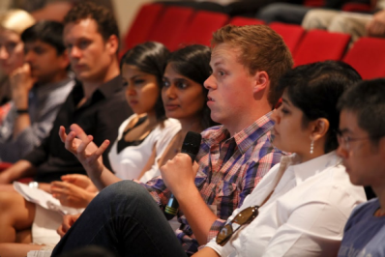
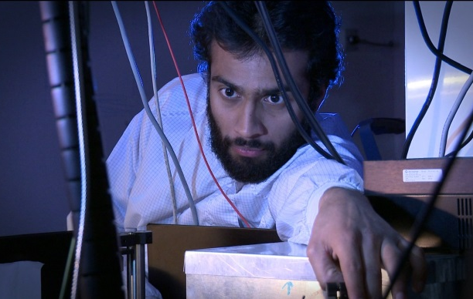
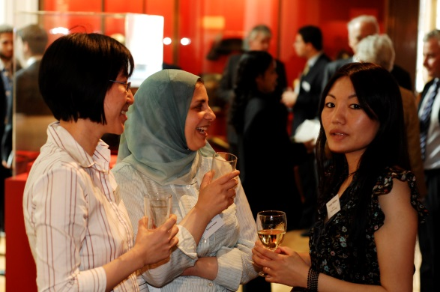
Application & selection
Our criteria
intellectual ability
choice of course
leadership capacity
a commitment to improving the lives of others
Not one template for a Gates Cambridge Scholar – see website (News and Directory for diversity)
Notes:
These are our four selection criteria and how we interpret them.
Our Scholars come from diverse backgrounds and each brings something unique to the programme. We use four criteria to select them.
Academic excellence
To be competitive for a Gates Cambridge Scholarship candidates must show evidence of academic excellence (through their transcripts, references, experience and the potential to succeed on the chosen course). Academic departments at the University of Cambridge nominate only the most academically outstanding applicants for a Gates Cambridge Scholarship, which ensures that those whom we select will thrive at Cambridge.
University has minimum entry requirements – see https://www.graduate.study.cam.ac.uk/application-process/entry-requirements – but those nominated to Gates Cambridge will be at the very top end academically
Reasons for choice of course
You should be able to make a strong case for a particular postgraduate degree at Cambridge. PhD applicants (and most research MPhil applicants) will need to make contact with a potential supervisor with whom they will develop a research project, a summary of which is part of the application. You will need to demonstrate that you have the academic background and the necessary skills and expertise to complete the course. Taught MPhil and other applicants need to make a strong case for how completing the proposed course will facilitate their career plans. Gates Cambridge seeks Scholars who will have an academically transformative experience at Cambridge, so it is important that you fully research and justify the course for which you are applying.
A commitment to improving the lives of others
A defining characteristic of the Gates Cambridge programme is the commitment of our Scholars to improving the lives of others. We interpret this criterion broadly and applicants define it themselves by providing evidence of their past, current and future commitment to the societies in which they will live and work.
A capacity for leadership
Successful applicants must be able to demonstrate a capacity for leadership, which can be expressed in a multitude of ways. Applicants should provide evidence of their leadership experience to date and indicate the ways in which their leadership skills may have impact in the future careers.
Not one template
Huge diversity in terms of experience, background, area of interest and ways in which the Scholars meet the selection criteria.
Important applicant use our criteria to highlight your individual stories and achievements.
See website for examples and diversity.

Slide 10
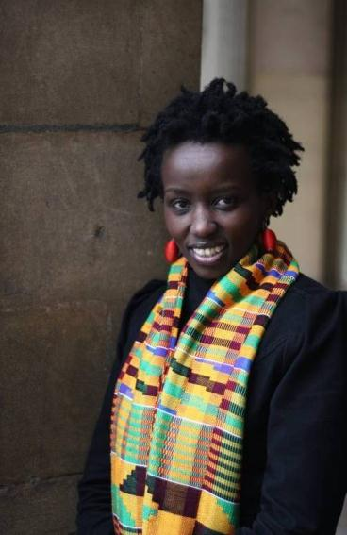
Application & selection
Gates Cambridge documents
In addition to main application, Gates Cambridge asks for:
Statement
“Please explain why you are applying for a Gates Cambridge Scholarship and how you meet the four main criteria [3,000 characters].”
Reference
“Please give your assessment of the applicant’s suitability a Gates Cambridge Scholarship.”
How highly would you rank the applicant for a Gates Cambridge Scholarship?
On what overall group are you basing this ranking?
What is the size of this group?
Notes:
Both are in addition to docs needed for application for admission
Statement submitted on the main Uni form but are
Referee requested via main form and will receive a link
Both are opportunities to show how you fit with our four criteria – should be targeted and use examples
Both read by shortlisting committee and interview panels
Used to reduce larger group nominated by departments to smaller groups for interviews and awards

Slide 11
Application & selection
Deadlines for October 2021
All applications open: 1 September 2020
Round 1: US citizens living in the USA
Deadline: 14 October 2020
Round 2: all other applicants
Deadlines: dependent on course, either:
3 December 2020 OR
7 January 2021
Notes:
Keep an eye on the deadlines as depends on the course you are applying to – you can see these on GAO page and in the application form itself, which has a countdown timer
Don’t leave it to the last minute.

Slide 12
How we select
Work flow
Departments nominate
Shortlisting committees review
Interview panels interview and select
c.80 academic departments
Arts
Biological Sciences
Arts
Biological Sciences
Physical Sciences
Social Sciences
Physical Sciences
Social Sciences
Academic ability
Justification for course Commitment to improving the lives of others Capacity for Leadership
Notes:
Gates Cambridge uses a three-stage selection process to ensure Scholars meet all of our criteria to the highest degree.
1. Departmental ranking
In order to ensure only the most academically outstanding candidates are considered, the Trust asks academic departments in Cambridge to rank eligible applicants on academic ability only. Those who are put forward by their departments are considered the most academically outstanding applicants they have received that year.
2. Shortlisting​
Once the Trust has a list of all nominated candidates, these are divided into broad subject areas and passed to our Shortlisting Committees. These Committees look at the candidates’ entire application pack (including the Gates Cambridge Statement and Reference) and apply all four Gates Cambridge criteria in order to identify those who will be invited for interview. Everyone who is shortlisted for interview will have gone through an exceptionally competitive process and will show evidence of meeting the four Gates Cambridge criteria.
3. Interview
All shortlisted candidates have a short interview to assess how they meet all four Gates Cambridge criteria and Scholars are selected after interview. Interview candidates will be sent full details of the format and arrangements. If you are shortlisted for interview you will have already gone through an incredibly competitive process
Full details on the website

Slide 13
How to make the best application
Quick tips
Fully research your proposed course
Be clear about why that course at Cambridge
Research and apply for all funding (see www.student-funding.cam.ac.uk)
Engage early with and fully brief your two academic referees and GC referee
Draft your application early and get input from others
Ensure you know your application deadline and apply in plenty of time
Notes:
Research course - important for admission and funding. Understand content of masters course and how it fits with you skills, experience and plans. Really interrogate the course website. For PhDs - engage early with your proposed department and contact relevant academics who look like they could supervise your planned research project. Ensure there is someone willing to supervise. Research resources - has Cambridge got what you need to successfully complete a PhD in area of research?
Why course at Cambridge - this is a GC criterion but also good for admission and other funding to be able to make a strong case for a specific course at Cambridge. How does it fit with your experience, skills and plans?
All funding - not just GC, plenty of other funding. Apply for everything you are eligible for. Much is via the form, but some is via separate applications. Funding search will guide you. Again, ensure you fully research each funding option and make your case about why your fit its specific criteria.
Referees - important to engage early with them, They will be busy and need you to provide details of your plans. True for 2 academic references but even more so for GC reference - that ref just hit all 4 GC buttons - not a third academic reference and not a rehash of a standard scholarship reference.
Input from others - always useful to get external input on your draft application. Ask friends, Colleagues, academics and those who have undertaken postgraduate study if they can spare time to review and feed back so you can home your application.
Deadline - don t miss them! But also don't submit at the last minute! Allow for technical issues, last minute changes and the unexpected t happen. There are no extensions

Slide 14
Further information
Website
www.gatescambridge.org
Need more information?
Email: info@gatescambridge.org
All Cambridge funding opportunities
‘Funding search’ page
www.student-funding.cam.ac.uk

Slide 15
Additional slides
Only if needed/for reference

Slide 16
Application & selection
Numbers by selection stage
Stage | US round | International round
Total applications | c.700 | c. 5,000
Departments nominate & shortlisting Committees review | c.150 | c.200
Shortlisting Committees put forward for interview | c. 75 | c.110
Interview Panels select | c.25 | c. 55
Total: 80 awards per year. 2/3 PhD awards; 1/3 Masters
Notes:
Two application rounds per year
US citizens normally resident in the USA
Citizens of all countries other than the USA (except the United Kingdom), and US citizens normally resident outside the USA
Competitive
Highly competitive but those who meet the criteria are strongly encouraged to apply
Many Scholars thought they would not be successful and have been

Slide 17
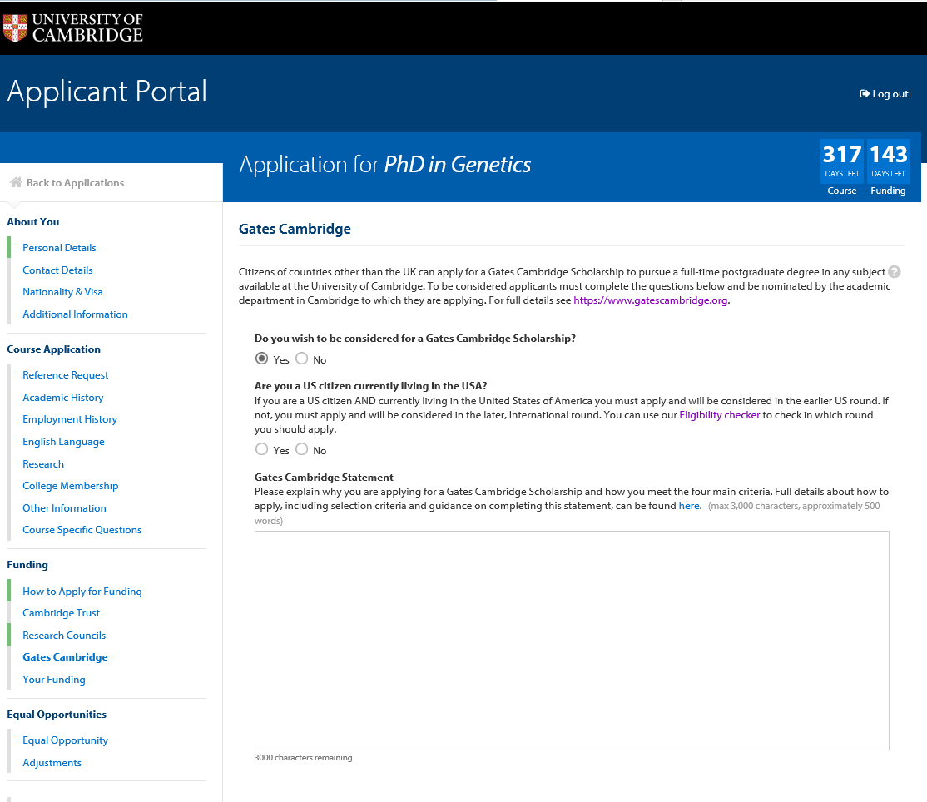
Application & selection
The form

Slide 18
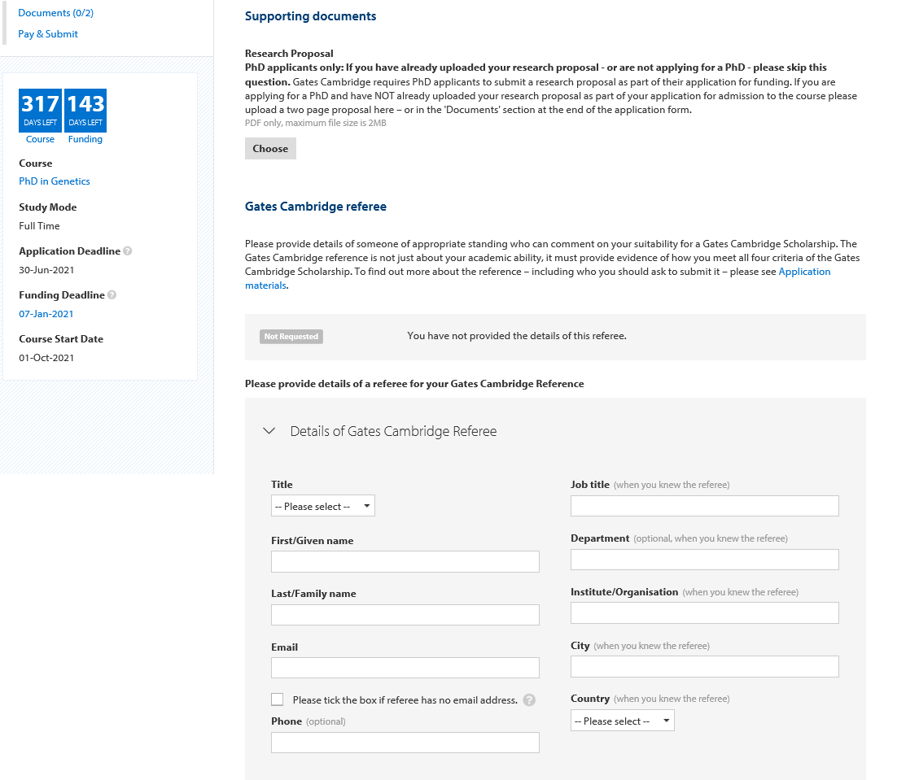
Application & selection
The form
Notes:
The statement is used by the Gates Cambridge shortlisting committees to distinguish between candidates who have been highly ranked by departments on academic grounds. It helps our committees identify those candidates who, as well as being academically outstanding, possess a capacity for leadership and commitment to improving the lives of others. This is the only part of the application form where applicants are specifically asked about their fit with the Gates Cambridge programme and you should use your background, achievements, experiences and future aims to show how you would be a good fit with the Gates Cambridge programme.
Targeted
Must hit all Gates Cambridge buttons
Should NOT be a re-hash of personal statement for another scholarship
Need to give interviewers something to talk about – allow them to draw out applicants Gates Cambridge qualities
Distinguish
Anything that shows an interesting or unique way they fit the Gates Cambridge profile is useful
Key points
Applicants chance to convince us they are a good fit with the Gates Cambridge programme
Look through website for help and inspiration

Slide 19
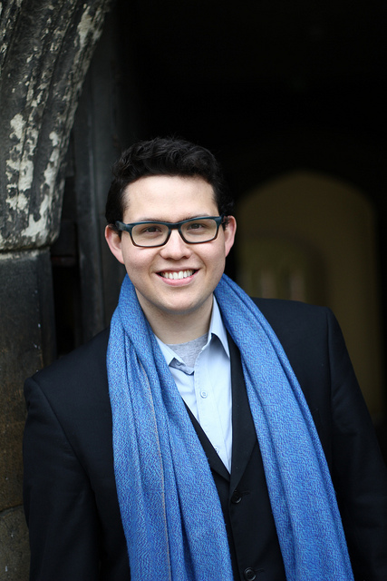
Application & selection
The application pack
Parts of the application
Application form
3 References (2 academic, 1 for Gates)
Academic transcripts
If PhD applicant a research proposal
Any other documents required by University
No institutional nomination required
Notes:
The application pack
Must complete a full application pack for admission and funding
Gates Cambridge: must tick Gates box in funding section, write a Gates Statement and ensure Gates Reference is submitted; (and research proposal if PhD)
Some further documents may be required – e.g. English Language test score if not first language; some departments ask for writing sample etc. Check websites
No institutional nomination is required – open application
Submitting and managing your application
University and Gates encourage to submit on-line as more efficient for everyone, although paper application is available
University application fee is £65 – unless from a country with a fee waiver (https://www.graduate.study.cam.ac.uk/application-process/how-do-i-apply/application-fee); Gates does not charge an additional application fee
Once submitted there is an on-line area - Self Service - to manage your application: upload documents, see progress, etc.

Slide 20
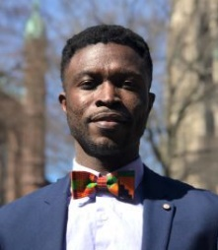
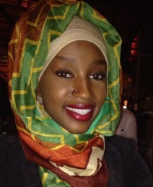
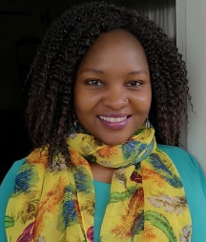
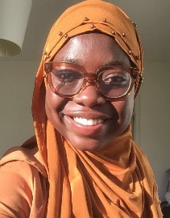
Scholars and Alumni
If using this slide, please use the Directory to update it with
scholars and alumni that are relevant to your presentation. This slide was for an
outreach event for Africans so do not use as is for general/other area presentations.
Shadrack Frimpong (2020)
Ghana, PhD Public Health
Grew up in rural Ghana without running water and electricity; founded an award-winning non-profit in US, will research how community engagement improves health outcomes in Ghana.
Rumbidzai Dube (2019)
Zimbabwe, PhD Politics & IR
Over a decade of experience as a human rights lawyer and promoting a range of rights across the African continent. Researching colonial state boundaries.
Patrick Rafidimanantsoa (2014)
Madagascar, MPhil Conservsation Leadership
Degrees in Forestry, Development and Environment, previously environmental manager for cashew farmer and currently ESPA Research Fellow at Bangor University.
Mamasa Camara (2016 and 2018)
USA/The Gambia, MPhil African Studies & PhD Gender Studies
Combines her research on female circumcision with a strong record of activism in women’s health in West Africa.
Aishat Yusuf (2019)
Nigeria, PhD Medical Science
Researching early diagnosis of oesophageal cancer through the identification of biomarkers. Currently on Scholars’ Council planning orientation for new scholars.
Thabo Misibi (2009)
South Africa, PhD Education
Currently Associate Professor, Dean and Head of School of Education, University of Kwazulu Natal.
Notes:
Update as needed for event – e.g. African scholars, US scholars, etc.

